Slide 1
Description of the Information System Product and its comparison to existing systems
Description:
A web application that can allow users to input a GitHub username, then analyze that GitHub account’s behavior:
repositories,
number of commits,
programming language preferences, etc.,
Present the information in a visualization report
Context:
Manually searching for the github repo information of particular users can be quite complex and time-consuming
Benefits:
Automate the analysis tasks
Clear display of analysis
Can be used by everyone - scalability

Slide 2
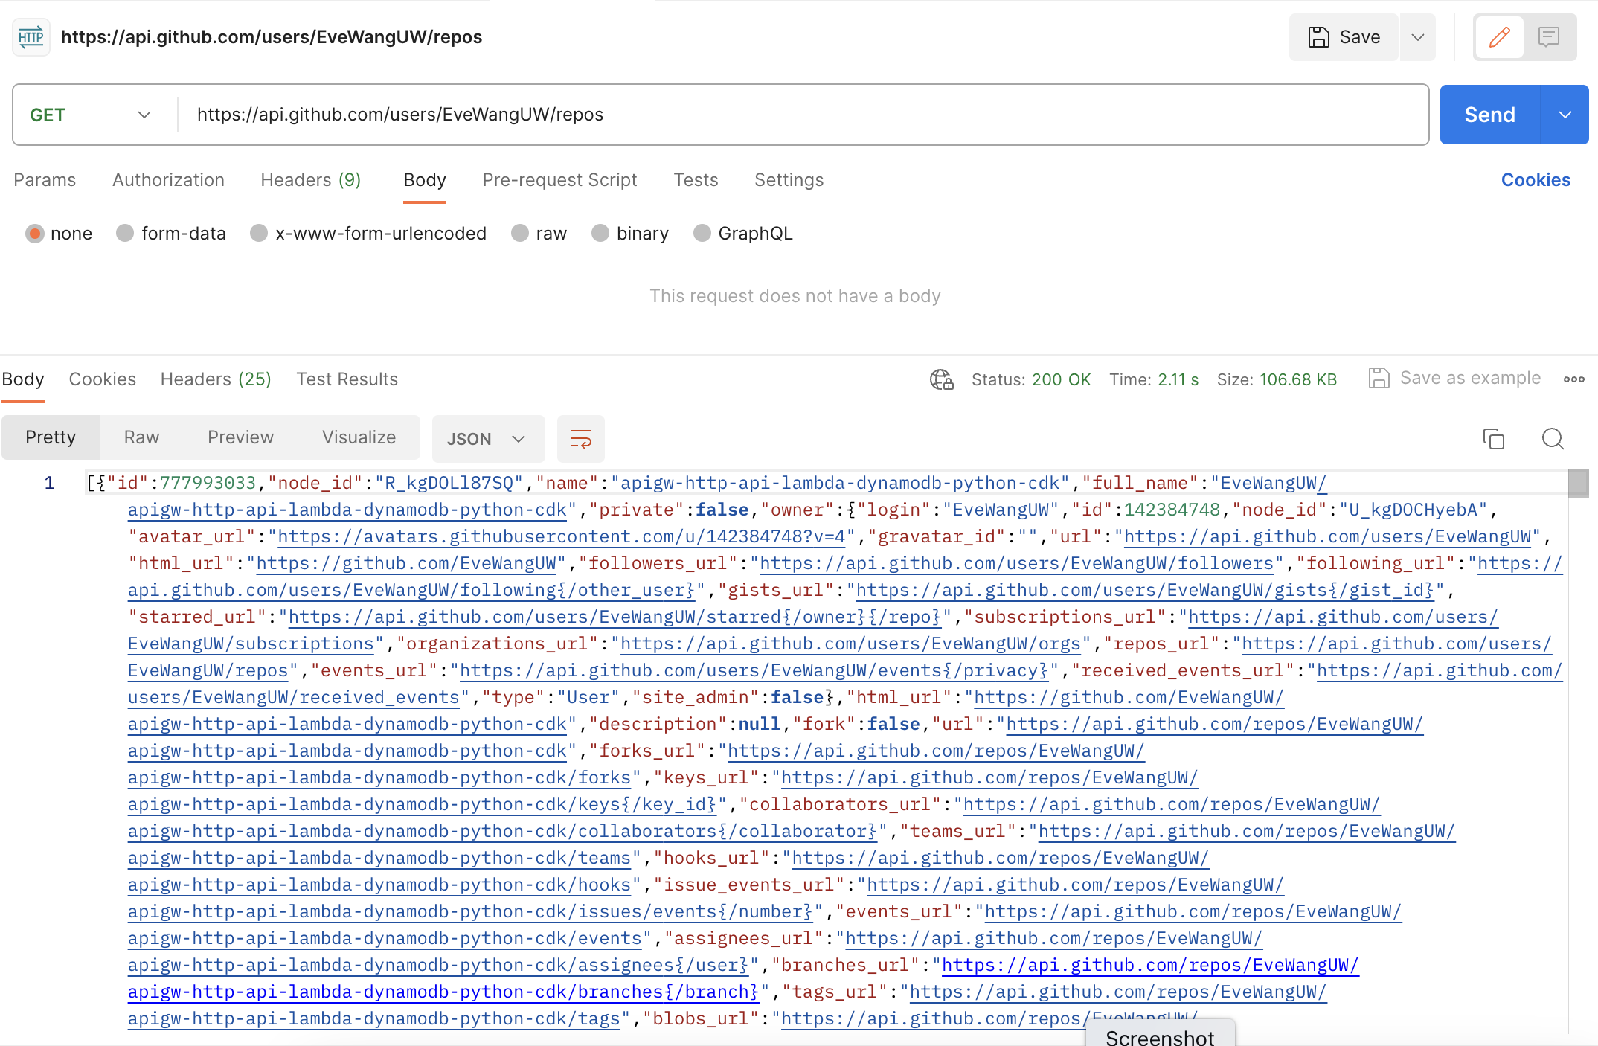
Information wireframes
GET GitHub User's Public Repos
https://api.github.com/users/{{owner}}/repos
No API Key needed

Slide 3
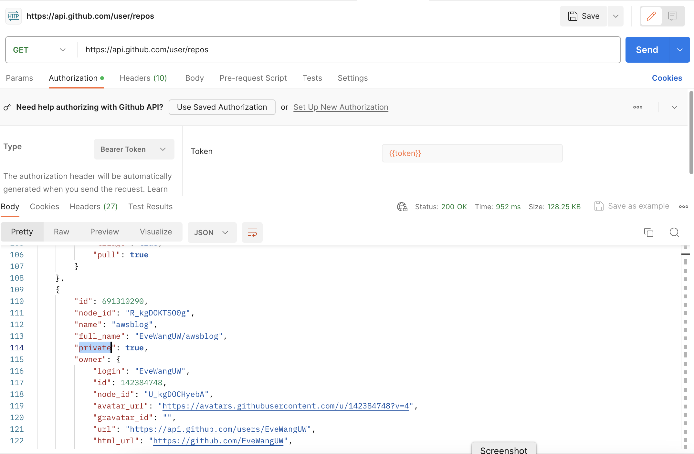
Information wireframes
GET GitHub User's Public and Private Repos
https://api.github.com/user/repos
API Key

Slide 4
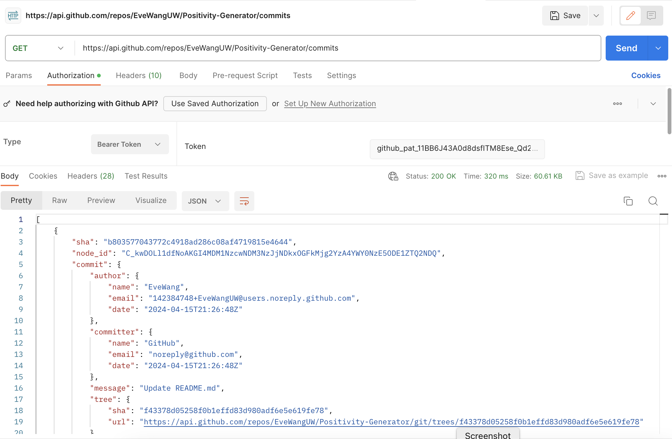
Information wireframes
LIST GitHub Commits from Repo
https://api.github.com/repos/{{owner}}/{{repo_name}}/commits
API Key

Slide 5
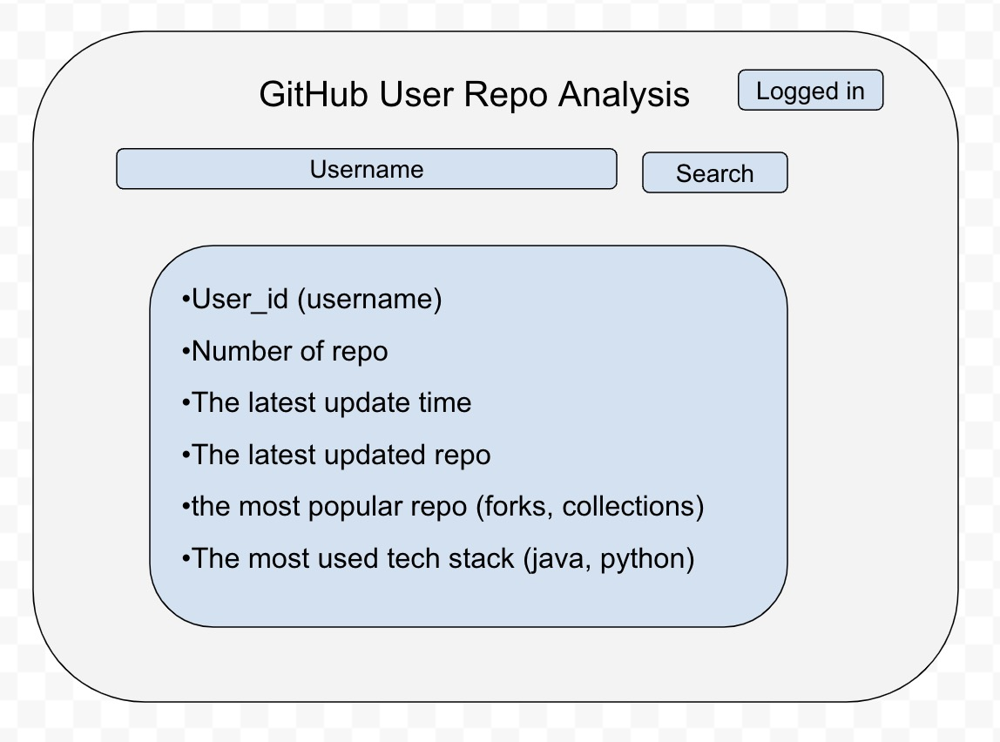
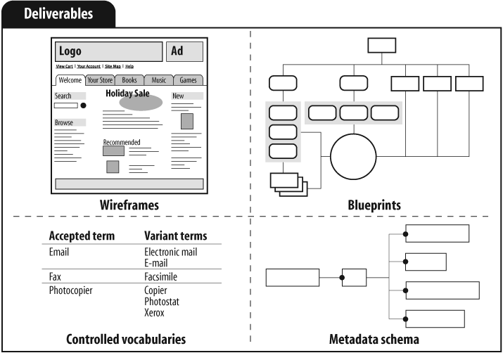
Information wireframes Slide 2: information wireframes (blueprint of how information is organization and/or UI wireframes that suggest how information is organized), and Slide 3: description of main concepts that ideally will be in the information product as either controlled vocab list or metadata scheme/taxonomy,

Slide 6
Description of main concepts
controlled vocab list or metadata scheme/taxonomy
User_id (username)
Number of repo
The latest update time
The latest updated repo
the most popular repo (forks, collections)
The most used tech stack (java, python)

Slide 7
Basic Architecture for System
Hosting: Localhost
Information structure:
username and their github behaviour information (detail in the previous slide)
Technologies:
React & TypeScript, Java & SpringBoot / Python & Flask, Material UI
Questions:
OAuth2.0 login (to enhance security)
Email notification for updates from subscribed users (new repo/commits)
A web application that allows you to search for popular repositories based on star ratings, programming languages, users, etc.

Slide 8
